Slide 1

Welcome to the labs!
Welcome to the Labs
Hashing Functions

Slide 2
Who are the tutors?

Slide 3
Who are you?

Slide 4








People Bingo
Rules: 1) Read each square. 2) Find a new friend who can complete any of the squares. 3) One friend can fill in one square only. 4) The first person to fill in every square wins!
Can fluently speak more than one language 🗣 | Has been to GPN before 💚 | Has visited another country ✈️ | Can play chess ♟ | Has more than 1 pet 🐶
Favourite food is Pizza 🍕 | Knows what a Kumquat is ❓ | Has made their own pasta 🍝 | Has eaten Dragon fruit 🐲 | Was born in another country 🌎
Knows how to Juggle 🤹‍♀️ | Likes to play Tetris 🎮 | Is an only child 👨‍👩‍👧 | Likes to paint 🎨 | Knows a magic trick 🪄
Plays an instrument 🎶 | Can ride a skateboard 🛹 | Likes to read 📖 | Has the same favourite colour as you 🌈 | Has the same eye colour as you 👀
Has a part time or casual job 💰 | Is in the same school year as you 🚌 | Knows the second verse of the national anthem 🇦🇺 | Has created their own coding project 💻 | Plays sport on the weekend ⚽️

Slide 5
Tell us you’re here!
Click on the
Start of Day Survey
and fill it in now!

Slide 6
Today’s project!
Password Cracker!

Slide 7

Using the workbook!
The workbooks will help you put your project together!
Each Part of the workbook is made of tasks!
Tasks - The parts of your project
Follow the tasks in order to make the project!
Task 6.2: Add a blah to your code!
This has instructions on how to do a part of the project Start by doing this part Then you can do this part
Hints - Helpers for your tasks!
Stuck on a task, we might have given you a hint to help you figure it out! The hints have unrelated examples, or tips. Don’t copy and paste in the code, you’ll end up with something CRAZY!
Task 6.1: Make the thing do blah!
Make your project do blah ….
Hint
A clue, an example or some extra information to help you figure out the answer.
print('This example is not part of the project’)

Slide 8

Using the workbook!
The workbooks will help you put your project together!
Check off before you move on from a Part! Do some bonuses while you wait!
Checklist - Am I done yet?
Make sure you can tick off every box in this section before you go to the next Part.
CHECKPOINT
If you can tick all of these off you’re ready to move the next part! ☐ Your program does blah ☐ Your program does blob
Lecture Markers
This tells you you’ll find out how to do things for this section during the names lecture.
Bonus Activities
Stuck waiting at a lecture marker?
Try a purple bonus. They add extra functionality to your project along the way.
★ BONUS 4.3: Do some extra!
Something to try if you have spare time before the next lecture!

Slide 9

If Statements

Slide 10

Conditions
Sometimes, we want our code to make choices.
This means certain parts will only run if certain conditions are met.
Conditions can either be True or False.
Computers call true/false values booleans.
If it’s raining take an umbrella
Yep it’s raining
…... take an umbrella

Slide 11
If Statements
We use if/elif/else statements to:
check which conditions are True/False
pick which parts of the code to run
word = "Chocolate"
if word == "GPN":
print("GPN is awesome!")
elif word == "Chocolate":
print("YUMMM Chocolate!")
else:
print("The word isn’t GPN :(")
What is “elif”?
What happens??
elif is short for “else if”

Slide 12
Project Time!
You now know all about if and else!
Let’s put what we learnt into our project
Try to do Parts 0 - 2!
The tutors will be around to help!

Slide 13
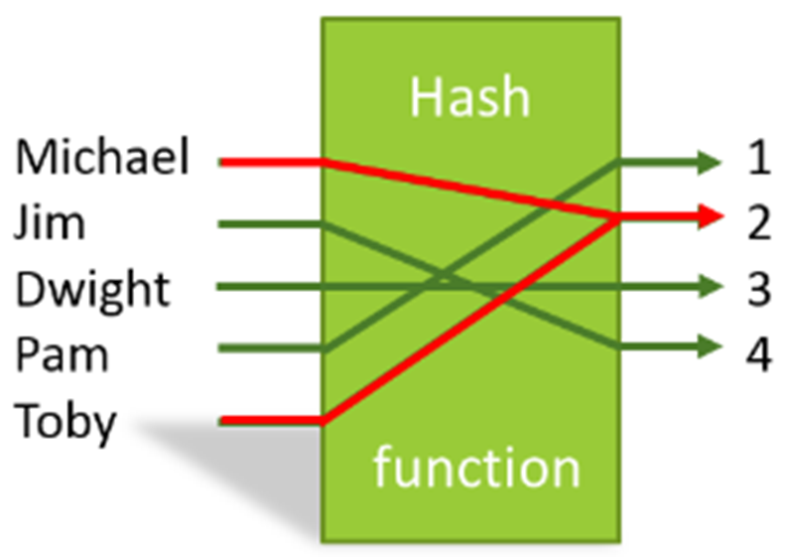
Hashing

Slide 14
What is Hashing?
Hashing is the process of converting any piece of data (called a key) into another value.
A hash function is used to generate the new value according to a mathematical algorithm.
The result of a hash function is known as a hash value.
Reference from: https://www.educative.io/edpresso/what-is-hashing

Slide 15
What is Hashing?
How does it work?
We take a readable word or phrase (this is called plaintext) like this:
password
This is a plaintext word that we can read!

Slide 16
What is Hashing?
How does it work?
We take a readable word or phrase (this is called plaintext) like this:
And we use a “Hash function” to turn it into something we can’t read!
password
b'\xcc\xd6R\x16\xb9\x1bP~lK\x01\x0e\x063\x10\xec'
This is a plaintext word that we can read!
This is the Hash Function
This is a hash value that we can’t read!

Slide 17
What is Hashing?
The coolest thing about a Hash function is that you can only go one way, so you can’t work out what the plaintext word was if you only have the hash value - this makes it secure!
x
password
b'\xcc\xd6R\x16\xb9\x1bP~lK\x01\x0e\x063\x10\xec'
This is a plaintext word that we can read!
This is the Hash Function
This is a hash value that we can’t read!

Slide 18
Hashing in Python
Firstly to use the Python code we need to import the hashing library!
We can do this by writing:
import hashlib
at the top of our code!

Slide 19
Encoding!
Next we need to prepare our data for hashing -
by encoding it!
my_string = “hello”
my_string_encoded = my_string.encode()
Encode
8-bit
H
01101000
The computer can read this ‘utf-8’ type and hash it!

Slide 20
Hashing!
We had to encode the string as only very specific data types like “utf-8” can be hashed.
Now we can actually hash our value!
To hash a value we can use the .md5 function written:
my_string_hashed = hashlib.md5(my_string_encoded)

Slide 21
Digest!
After hashing our variable we want to turn it into a value we can use, so we use the .digest() method, written:
my_string_hashed = hashlib.md5(my_string_encoded).digest()
print(my_string_hashed)
Result:
b']A@*\xbcK*v\xb9q\x9d\x91\x10\x17\xc5\x92'

Slide 22
Project Time!
Hashing!
Let’s put what we learnt into our project
Try to do Parts 3 - 5!
The tutors will be around to help!

Slide 23


Rainbow Tables

Slide 24
What is a Rainbow Table?
How can we figure out a password?
Remember that we can not work backwards
from a hash because they are irreversible
But every unique string gives a unique hash
(e.g. if you hash ‘apple’ it will always give the same hash)
What if we work forwards instead?
We could guess the password!

Slide 25
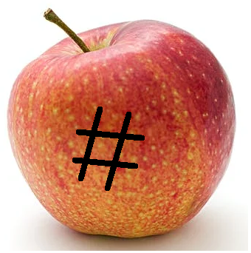
What is a Rainbow Table?
Plaintext password = 'apple'
hashed password = b’\x1f8p\xbe'OlI\xb3\xe3\x1a\x0cg(\x95\x7f’

Slide 26
What is a Rainbow Table?
We can make a lot of guesses!
A rainbow table is a collection of a lot of possible passwords
and their hashes
It makes sense to use the most common passwords in the table
This will help you break into the most accounts!
Rainbow tables show you “the entire spectrum of possibilities”.
https://stackoverflow.com/questions/5051608/why-is-it-called-rainbow-table

Slide 27

Let's Crack a password
We've discovered a list of leaked password hashes.
Let's try and crack one of them with a rainbow table!
What's the plaintext of
b'\xe8\x07\xf1\xfc\xf8-\x13/\x9b\xb0\x18\xcag8\xa1\x9f'

Slide 28
Our rainbow table
Plaintext | Hashes
password | b'_M\xcc;Z\xa7e\xd6\x1d\x83'\xde\xb8\x82\xcf\x99'
password123 | b'H,\x81\x1d\xa5\xd5\xb4\xbcmI\x7f\xfa\x98I\x1e8'
p@ssw0rd | b'\x0f5\x97@\xbd\x1c\xda\x99O\x8bU3\x0c\x86\xd8E'
1234567890 | b'\xe8\x07\xf1\xfc\xf8-\x13/\x9b\xb0\x18\xcag8\xa1\x9f'
qwerty | b'\xd8W\x8e\xdf\x84X\xce\x06\xfb\xc5\xbbv\xa5\x8c\\\xa4'
qwerty123 | b'?\xc0\xa7\xac\xf0\x87\xf5I\xac+&k\xaf\x94\xb8\xb1'
Notes:
Code to get hashvalues: import hashlib
plaintext="qwerty" plaintext_encoded=plaintext.encode() print(hashlib.md5(plaintext_encoded).digest())

Slide 29
Let's Crack a password
Hash to crack: b'\xe8\x07\xf1\xfc\xf8-\x13/\x9b\xb0\x18\xcag8\xa1\x9f'
Do these match?
Plaintext | Hashes
password | b'_M\xcc;Z\xa7e\xd6\x1d\x83'\xde\xb8\x82\xcf\x99'
password123 | b'H,\x81\x1d\xa5\xd5\xb4\xbcmI\x7f\xfa\x98I\x1e8'
p@ssw0rd | b'\x0f5\x97@\xbd\x1c\xda\x99O\x8bU3\x0c\x86\xd8E'
1234567890 | b'\xe8\x07\xf1\xfc\xf8-\x13/\x9b\xb0\x18\xcag8\xa1\x9f'
qwerty | b'\xd8W\x8e\xdf\x84X\xce\x06\xfb\xc5\xbbv\xa5\x8c\\\xa4'
qwerty123 | b'?\xc0\xa7\xac\xf0\x87\xf5I\xac+&k\xaf\x94\xb8\xb1'

Slide 30
Let's Crack a password
Hash to crack: b'\xe8\x07\xf1\xfc\xf8-\x13/\x9b\xb0\x18\xcag8\xa1\x9f'
Do these match? No, let's try the next one
Plaintext | Hashes
password | b'_M\xcc;Z\xa7e\xd6\x1d\x83'\xde\xb8\x82\xcf\x99'
password123 | b'H,\x81\x1d\xa5\xd5\xb4\xbcmI\x7f\xfa\x98I\x1e8'
p@ssw0rd | b'\x0f5\x97@\xbd\x1c\xda\x99O\x8bU3\x0c\x86\xd8E'
1234567890 | b'\xe8\x07\xf1\xfc\xf8-\x13/\x9b\xb0\x18\xcag8\xa1\x9f'
qwerty | b'\xd8W\x8e\xdf\x84X\xce\x06\xfb\xc5\xbbv\xa5\x8c\\\xa4'
qwerty123 | b'?\xc0\xa7\xac\xf0\x87\xf5I\xac+&k\xaf\x94\xb8\xb1'

Slide 31
Let's Crack a password
Hash to crack: b'\xe8\x07\xf1\xfc\xf8-\x13/\x9b\xb0\x18\xcag8\xa1\x9f'
Do these match?
Plaintext | Hashes
password | b'_M\xcc;Z\xa7e\xd6\x1d\x83'\xde\xb8\x82\xcf\x99'
password123 | b'H,\x81\x1d\xa5\xd5\xb4\xbcmI\x7f\xfa\x98I\x1e8'
p@ssw0rd | b'\x0f5\x97@\xbd\x1c\xda\x99O\x8bU3\x0c\x86\xd8E'
1234567890 | b'\xe8\x07\xf1\xfc\xf8-\x13/\x9b\xb0\x18\xcag8\xa1\x9f'
qwerty | b'\xd8W\x8e\xdf\x84X\xce\x06\xfb\xc5\xbbv\xa5\x8c\\\xa4'
qwerty123 | b'?\xc0\xa7\xac\xf0\x87\xf5I\xac+&k\xaf\x94\xb8\xb1'

Slide 32
Let's Crack a password
Hash to crack: b'\xe8\x07\xf1\xfc\xf8-\x13/\x9b\xb0\x18\xcag8\xa1\x9f'
Do these match? No, let's try the next one
Plaintext | Hashes
password | b'_M\xcc;Z\xa7e\xd6\x1d\x83'\xde\xb8\x82\xcf\x99'
password123 | b'H,\x81\x1d\xa5\xd5\xb4\xbcmI\x7f\xfa\x98I\x1e8'
p@ssw0rd | b'\x0f5\x97@\xbd\x1c\xda\x99O\x8bU3\x0c\x86\xd8E'
1234567890 | b'\xe8\x07\xf1\xfc\xf8-\x13/\x9b\xb0\x18\xcag8\xa1\x9f'
qwerty | b'\xd8W\x8e\xdf\x84X\xce\x06\xfb\xc5\xbbv\xa5\x8c\\\xa4'
qwerty123 | b'?\xc0\xa7\xac\xf0\x87\xf5I\xac+&k\xaf\x94\xb8\xb1'

Slide 33
Let's Crack a password
Hash to crack: b'\xe8\x07\xf1\xfc\xf8-\x13/\x9b\xb0\x18\xcag8\xa1\x9f'
Do these match?
Plaintext | Hashes
password | b'_M\xcc;Z\xa7e\xd6\x1d\x83'\xde\xb8\x82\xcf\x99'
password123 | b'H,\x81\x1d\xa5\xd5\xb4\xbcmI\x7f\xfa\x98I\x1e8'
p@ssw0rd | b'\x0f5\x97@\xbd\x1c\xda\x99O\x8bU3\x0c\x86\xd8E'
1234567890 | b'\xe8\x07\xf1\xfc\xf8-\x13/\x9b\xb0\x18\xcag8\xa1\x9f'
qwerty | b'\xd8W\x8e\xdf\x84X\xce\x06\xfb\xc5\xbbv\xa5\x8c\\\xa4'
qwerty123 | b'?\xc0\xa7\xac\xf0\x87\xf5I\xac+&k\xaf\x94\xb8\xb1'

Slide 34
Let's Crack a password
Hash to crack: b'\xe8\x07\xf1\xfc\xf8-\x13/\x9b\xb0\x18\xcag8\xa1\x9f'
Do these match? No, let's try the next one.
Plaintext | Hashes
password | b'_M\xcc;Z\xa7e\xd6\x1d\x83'\xde\xb8\x82\xcf\x99'
password123 | b'H,\x81\x1d\xa5\xd5\xb4\xbcmI\x7f\xfa\x98I\x1e8'
p@ssw0rd | b'\x0f5\x97@\xbd\x1c\xda\x99O\x8bU3\x0c\x86\xd8E'
1234567890 | b'\xe8\x07\xf1\xfc\xf8-\x13/\x9b\xb0\x18\xcag8\xa1\x9f'
qwerty | b'\xd8W\x8e\xdf\x84X\xce\x06\xfb\xc5\xbbv\xa5\x8c\\\xa4'
qwerty123 | b'?\xc0\xa7\xac\xf0\x87\xf5I\xac+&k\xaf\x94\xb8\xb1'

Slide 35
Let's Crack a password
Hash to crack: b'\xe8\x07\xf1\xfc\xf8-\x13/\x9b\xb0\x18\xcag8\xa1\x9f'
Do these match?
Plaintext | Hashes
password | b'_M\xcc;Z\xa7e\xd6\x1d\x83'\xde\xb8\x82\xcf\x99'
password123 | b'H,\x81\x1d\xa5\xd5\xb4\xbcmI\x7f\xfa\x98I\x1e8'
p@ssw0rd | b'\x0f5\x97@\xbd\x1c\xda\x99O\x8bU3\x0c\x86\xd8E'
1234567890 | b'\xe8\x07\xf1\xfc\xf8-\x13/\x9b\xb0\x18\xcag8\xa1\x9f'
qwerty | b'\xd8W\x8e\xdf\x84X\xce\x06\xfb\xc5\xbbv\xa5\x8c\\\xa4'
qwerty123 | b'?\xc0\xa7\xac\xf0\x87\xf5I\xac+&k\xaf\x94\xb8\xb1'

Slide 36
Let's Crack a password
Hash to crack: b'\xe8\x07\xf1\xfc\xf8-\x13/\x9b\xb0\x18\xcag8\xa1\x9f'
Do these match? Yes! Now we can get the plaintext.
Plaintext | Hashes
password | b'_M\xcc;Z\xa7e\xd6\x1d\x83'\xde\xb8\x82\xcf\x99'
password123 | b'H,\x81\x1d\xa5\xd5\xb4\xbcmI\x7f\xfa\x98I\x1e8'
p@ssw0rd | b'\x0f5\x97@\xbd\x1c\xda\x99O\x8bU3\x0c\x86\xd8E'
1234567890 | b'\xe8\x07\xf1\xfc\xf8-\x13/\x9b\xb0\x18\xcag8\xa1\x9f'
qwerty | b'\xd8W\x8e\xdf\x84X\xce\x06\xfb\xc5\xbbv\xa5\x8c\\\xa4'
qwerty123 | b'?\xc0\xa7\xac\xf0\x87\xf5I\xac+&k\xaf\x94\xb8\xb1'

Slide 37
Let's Crack a password
Hash to crack: b'\xe8\x07\xf1\xfc\xf8-\x13/\x9b\xb0\x18\xcag8\xa1\x9f'
Do these match? Yes! Now we can get the plaintext. It's 1234567890
Plaintext | Hashes
password | b'_M\xcc;Z\xa7e\xd6\x1d\x83'\xde\xb8\x82\xcf\x99'
password123 | b'H,\x81\x1d\xa5\xd5\xb4\xbcmI\x7f\xfa\x98I\x1e8'
p@ssw0rd | b'\x0f5\x97@\xbd\x1c\xda\x99O\x8bU3\x0c\x86\xd8E'
1234567890 | b'\xe8\x07\xf1\xfc\xf8-\x13/\x9b\xb0\x18\xcag8\xa1\x9f'
qwerty | b'\xd8W\x8e\xdf\x84X\xce\x06\xfb\xc5\xbbv\xa5\x8c\\\xa4'
qwerty123 | b'?\xc0\xa7\xac\xf0\x87\xf5I\xac+&k\xaf\x94\xb8\xb1'

Slide 38
Choosing passwords
Storing hashes for every single possible password
would use up a lot of space.
So hackers usually only create rainbow tables
with the most common passwords……
Which is why you shouldn't use them. That would make your account very easy to get into.

Slide 39
Data Breaches
Stealing passwords is something criminals are always trying to do. These companies have had their users' passwords exposed online recently. How many of them do you use?
Facebook (2019) 533 million users
Linkedin (2021) 700 million users
Twitter (2018) 330 million users
Uber (2016) 57 million users
Twitch (2021) 7 million
Zoom (2020) 500,000
src: https://www.upguard.com/blog/biggest-data-breaches

Slide 40
Data Breaches
Stealing passwords is something criminals are always trying to do. These companies have had their users' passwords exposed online recently. How many of them do you use?
Facebook (2019) 533 million users
Linkedin (2021) 700 million users
Twitter (2018) 330 million users
Uber (2016) 57 million users
Twitch (2021) 7 million
Zoom (2020) 500,000
Imagine how easy it would be to hack into your accounts if they all used the same password!
src: https://www.upguard.com/blog/biggest-data-breaches

Slide 41
Project Time!
Now that you've learnt all about rainbow tables!
Let’s put what we learnt into our project
Try to do Part 0
of workbook 2!
The tutors will be around to help!

Slide 42
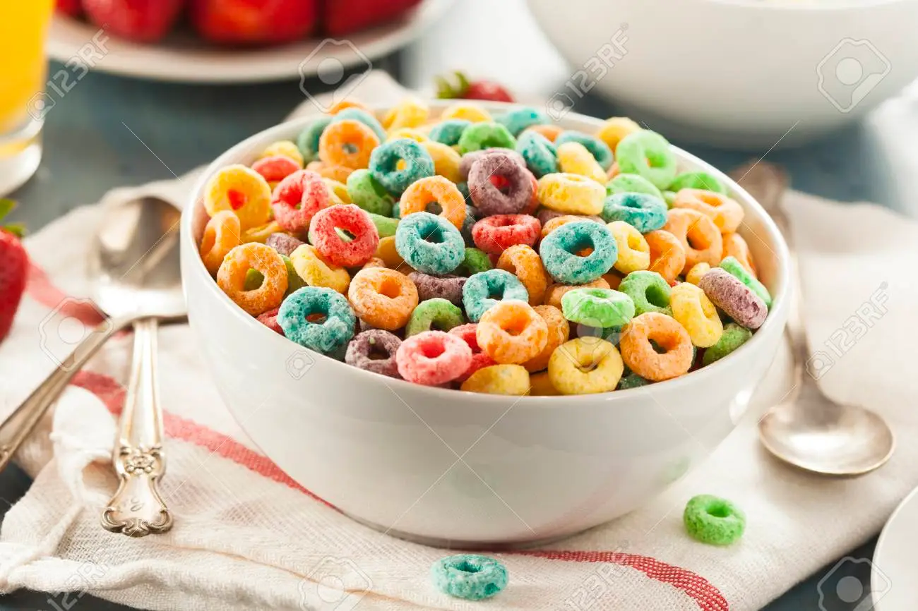
Files and For Loops

Slide 43

Opening files!
We can store information inside files.
Then we can use these files in our code!
To get access to the stuff inside a file in python, we need to open it!
(That doesn’t mean clicking on the little icon)
for line in open(“test.txt”):
print(line)
Important: The file needs to be in the same place as your code

Slide 44
Opening Files
Let’s break that code down a bit!
for line in open(“test.txt”):
print(line)
This bit is called a for loop, we’ll learn about that in the next few slides!

Slide 45
Opening Files
Let’s break that code down a bit!
for line in open(“test.txt”):
print(line)
This bit is called a for loop, we’ll learn about that in the next few slides!
Over here is where we tell our code that we want to open the file!

Slide 46
Opening Files
Let’s break that code down a bit!
for line in open(“test.txt”):
print(line)
Here is where we put the name of the file we want to open
This bit is called a for loop, we’ll learn about that in the next few slides!
Over here is where we tell our code that we want to open the file!

Slide 47
Opening Files
Let’s break that code down a bit!
for line in open(“test.txt”):
print(line)
Here is where we put the name of the file we want to open
This bit is called a for loop, we’ll learn about that in the next few slides!
Over here is where we tell our code that we want to open the file!
Finally, this is what we want to do with each line of the file.

Slide 48

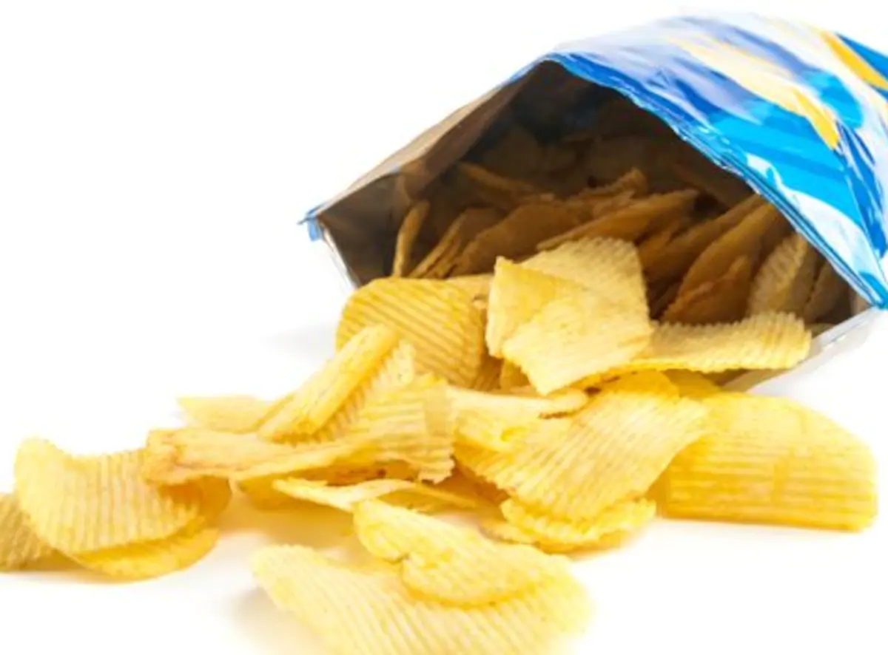
For Loops
For loops allow you to do something for each item in a group of things
There are many real world examples, like:
For each page in this book:
Read
For each chip in this bag of chips:
Eat

Slide 49
Reading line by line
My cat wrote this Haiku for me and I want my program to print out each line:
Wanna go outside.
Oh NO! Help I got outside!
Let me back inside!

Slide 50
Reading line by line
My cat wrote this Haiku for me and I want my program to print out each line:
Wanna go outside.
Oh NO! Help I got outside!
Let me back inside!
We can use for loops to read individual lines of files

Slide 51
Reading line by line
My cat wrote this Haiku for me and I want my program to print out each line:
Wanna go outside.
Oh NO! Help I got outside!
Let me back inside!
We can use for loops to read individual lines of files
for line in open('haiku.txt'):
print(line)
What do you think this will print?

Slide 52
Reading line by line
My cat wrote this Haiku for me and I want my program to print out each line:
Wanna go outside.
Oh NO! Help I got outside!
Let me back inside!
We can use for loops to read individual lines of files
for line in open('haiku.txt'):
print(line)
Wanna go outside. Oh NO! Help! I got outside! Let me back inside!
But there are extra lines?

Slide 53

Chomping off the newline
The newline character is represented by '\n':
print('Hello\nWorld') Hello World
We can remove it from the lines we read with .strip()
x = 'abc\n'
x.strip()
'abc'
Notes:
The newline character is kept on the end of the lines by default when you read in a file.
You can cut it off with the dot strip method - probably the safest way - or you can slice the string to take off the last character.

Slide 54

Reading and stripping!
for line in open('haiku.txt'):
line = line.strip()
print(line)
Wanna go outside. Oh NO! Help! I got outside! Let me back inside!
No extra lines!
Notes:
Running through this again, you can see there's only one newline this time - the newline coming from the print statement.

Slide 55


A missing file causes an error
This is what happens if you try to open a file that doesn’t exist:
open('missing.txt')
Traceback (most recent call last):
File "<stdin>", line 1, in <module>
IOError: [Errno 2] No such file or directory: 'missing.txt'
Notes:
You'll get an IOError if you try to open a file that apparently doesn't exist.
That might happen if you're trying to access a file that's not in the current directory.

Slide 56
Project Time!
Now you know how to use for loops and files!
Try to do Part 1
of workbook 2!!
The tutors will be around to help!

Slide 57

Dictionaries

Slide 58
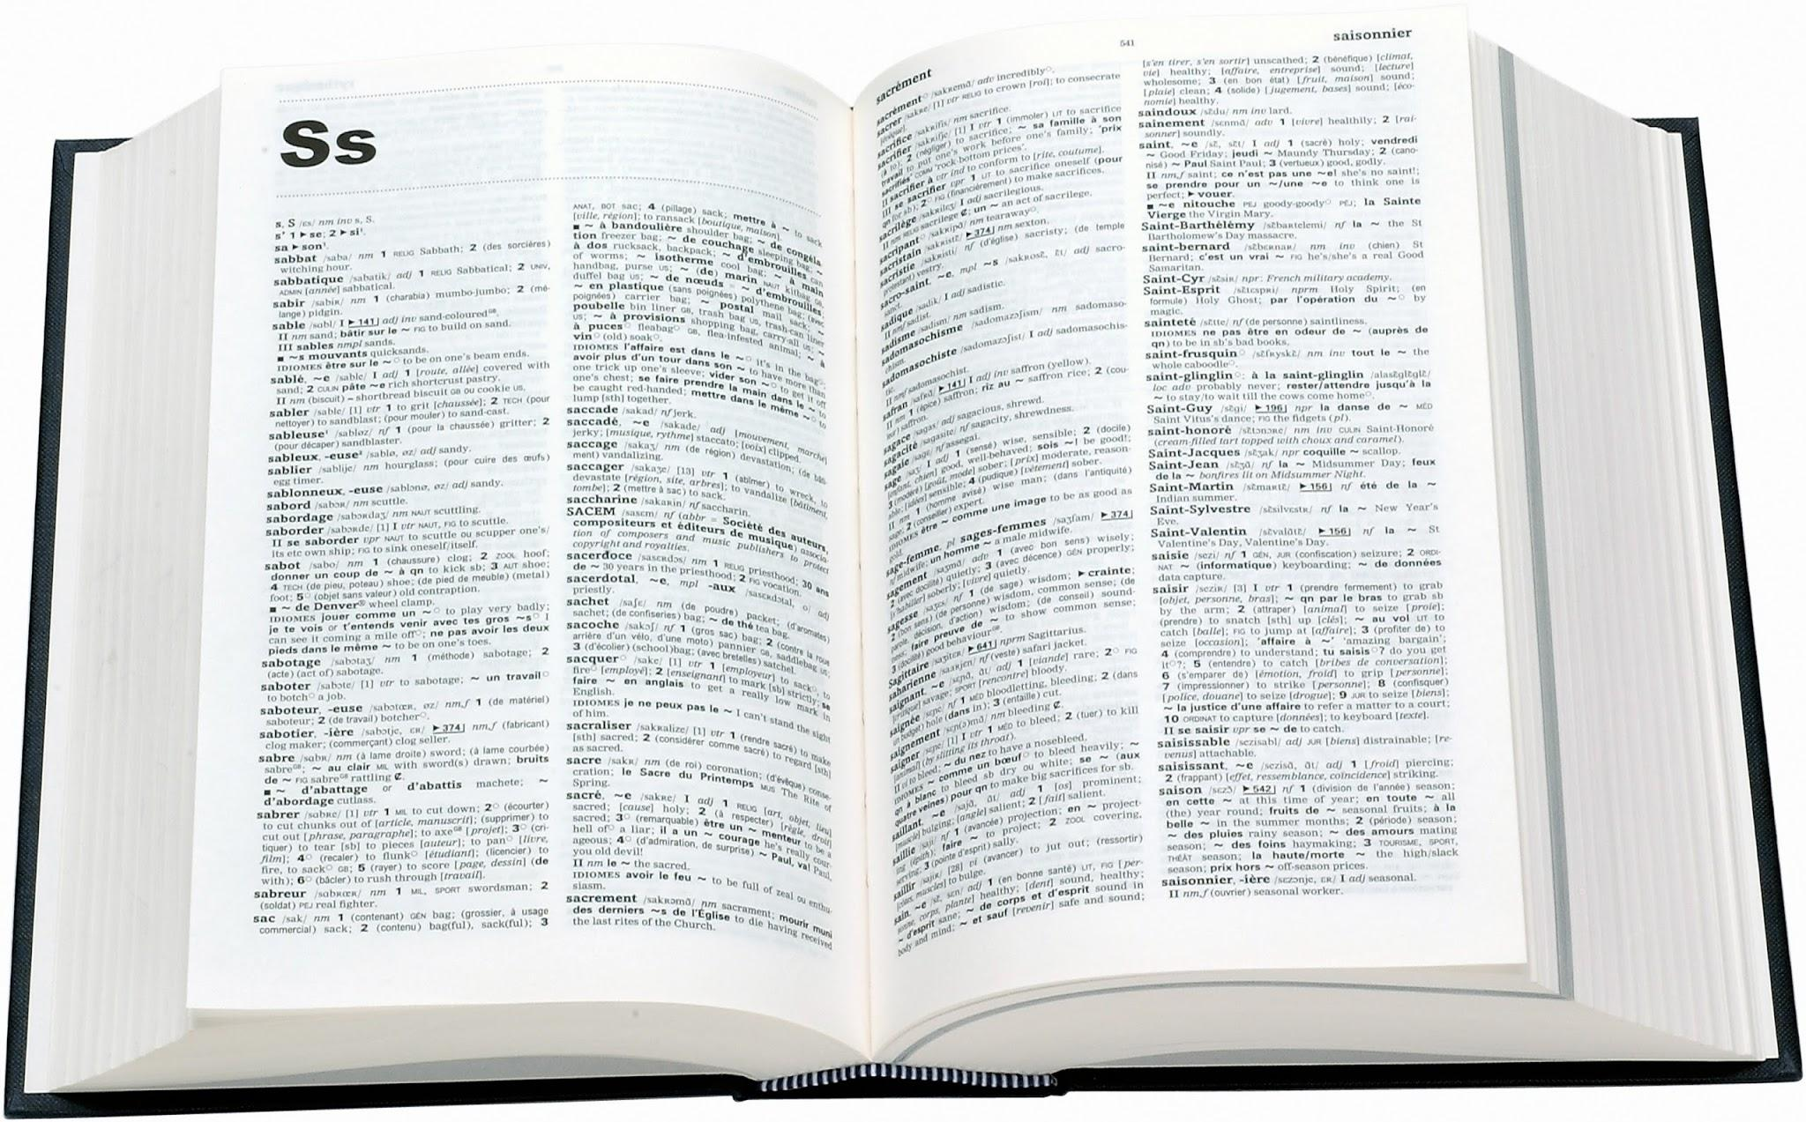
Dictionaries!
You know dictionaries!
They’re great at looking up thing by a word, not a position in a list!
Look up Hello
Get back A greeting (salutation) said when meeting someone or acknowledging someone’s arrival or presence.

Slide 59


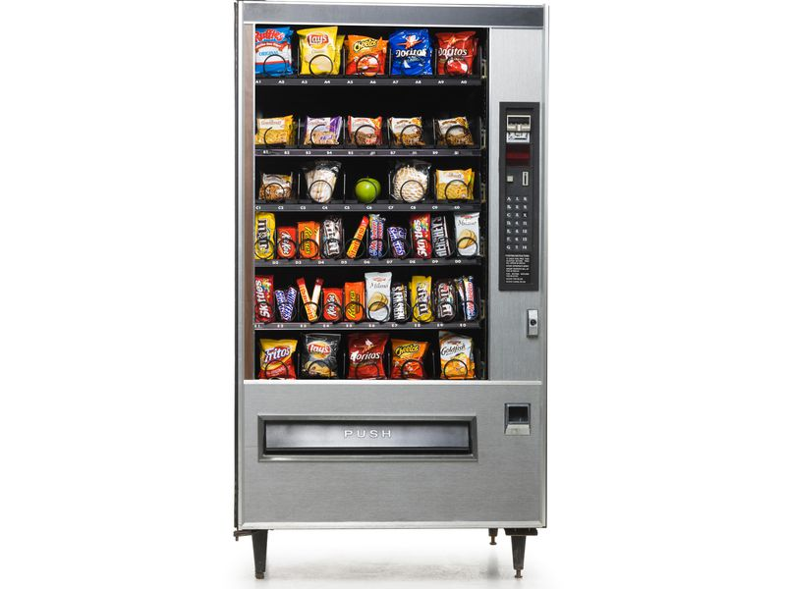
Looking it up!
There are lots of times we want to look something up!
Competition registration
Team Name → List of team members
Phone Book
Vending Machine
Name → Phone number
Treat Name → Price

Slide 60
Looking it up!
Phone Book
Name → Phone number
Key
Value
We can use a dictionary for anything with a key → value pattern!
Notes:
In programmer language
The “look up” part is called a KEY
The “get back” part is called a VALUE

Slide 61
Dictionaries anatomy!
This is a python dictionary!
This dictionary has Alex, Caitlin and Emma’s phone numbers
Stored in the variable phone_book
Made up of pairs of information
Each pair is made up of a key and value
The pairs are separated by commas
phone_book = {"Alex": 111, "Caitlin": 222, "Emma": 333}
Has squiggly brackets
Keys and values are separated by a colon

Slide 62
Playing with dictionaries!
Let’s try using the phone book!
Let’s create the phonebook
>>> phone_book = {
"Alex": 111, "Caitlin": 222, "Emma": 333
}
Let’s get Alex’s number from the phonebook. What will it be?
>>> phone_book["Alex"]

Slide 63
Playing with dictionaries!
Let’s try using the phone book!
Let’s create the phonebook
>>> phone_book = {
"Alex": 111, "Caitlin": 222, "Emma": 333
}
Let’s get Alex’s number from the phonebook. What will it be?
>>> phone_book["Alex"]
111

Slide 64
Updating our dictionaries!
Alex changed her number. Let’s update it!
>>> phone_book["Alex"] = 123
>>> print(phone_book)
We met Rowena! Let’s add her to our phone book
>>> phone_book["Rowena"] = 444
>>> print(phone_book)

Slide 65
Updating our dictionaries!
Alex changed her number. Let’s update it!
>>> phone_book["Alex"] = 123
>>> print(phone_book)
{ "Alex": 123, "Caitlin": 222, "Emma": 333 }
We met Rowena! Let’s add her to our phone book
>>> phone_book["Rowena"] = 444
>>> print(phone_book)

Slide 66
Updating our dictionaries!
Alex changed her number. Let’s update it!
>>> phone_book["Alex"] = 123
>>> print(phone_book)
{ "Alex": 123, "Caitlin": 222, "Emma": 333 }
We met Rowena! Let’s add her to our phone book
>>> phone_book["Rowena"] = 444
>>> print(phone_book)
{ "Alex": 123, "Caitlin": 222, "Emma": 333,
"Rowena": 444 }

Slide 67
Project time!
You now know all about dictionaries!
Let’s put what we learnt into our project
Try to do Part 2
of workbook 2!
The tutors will be around to help!

Slide 68

Python Lists

Slide 69
Lists can store multiple things
A list is an ordered group of related items, all stored in the same variable
>>> day1 = 'Monday'
>>> day2 = 'Tuesday'
>>> day3 = 'Wednesday'
>>> day4 = 'Thursday'
>>> day5 = 'Friday'
>>> day6 = 'Saturday'
>>> day7 = 'Sunday'
>>> days = ['Monday', 'Tuesday', 'Wednesday', 'Thursday', 'Friday', 'Saturday', 'Sunday']

Slide 70



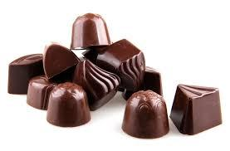
Your Favourite Things!
>>> faves = [‘books', ‘butterfly', ‘chocolate', 'skateboard']
[ , , , ]

Slide 71
Accessing Lists!
The favourites list holds four strings in order.
We can count out the items using index numbers!
0 1 2 3
-4 -3 -2 -1
Indices start from zero!

Slide 72
You can put (almost) anything into a list
You can have a list of integers
>>> primes = [1, 2, 3, 5, 11]
You can have lists with mixed integers and strings
>>> mixture = [1, 'two', 3, 4, 'five']
But this is almost never a good idea! You should be able to treat every element of the list the same way.

Slide 73
Falling off the edge
Python complains if you try to go past the end of a list
>>> faves = ['books', 'butterfly', 'chocolate', 'skateboard']
>>> faves[4]
Traceback (most recent call last):
File "<stdin>", line 1, in <module>
IndexError: list index out of range

Slide 74
Updating items!
We can also update things in a list:
>>> faves = ['books', 'butterfly', 'chocolate', 'skateboard']
>>> faves[1]
'Butterfly'
>>> faves[1] = 'new favourite'
>>> faves[1]
'new favourite'

Slide 75
Removing items!
We can remove items from the list if they’re no longer needed!
What if we decided that we didn’t like butterflies anymore?
>>> faves.remove('butterfly')
What does this list look like now?
[ , , ]

Slide 76
Looping over a list of ints
We can loop through a list:
numbers = [1, 2, 3, 4]
for i in numbers:
print(i)
What’s going to happen?

Slide 77
Looping over a list of ints
We can loop through a list:
Each item of the list takes a turn at being the variable i
Do the body once for each item
We’re done when we run out of items!
numbers = [1, 2, 3, 4]
for i in numbers:
print(i)
What’s going to happen?
>>> 1
>>> 2
>>> 3
>>> 4

Slide 78
Project time!
Lists!
Let’s put what we learnt into our project
Try to do Parts 3 - 4
of workbook 2!
The tutors will be around to help!

Slide 79
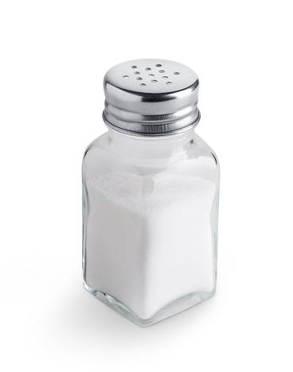
Salting

Slide 80
What is Salting?
Password salting is a technique to protect passwords stored in databases by adding a string of 32 or more characters and then hashing them.
Salting prevents hackers who breach an enterprise environment from reverse-engineering passwords and stealing them from the database.

Slide 81
Normal Hashing
Usually when you hash a password it looks like this:
password
b'\xcc\xd6R\x16\xb9\x1bP~lK\x01\x0e\x063\x10\xec'
This is the Hash Function
This is a plaintext word that we can read!
This is a hash value that we can’t read!

Slide 82
Normal Hashing
Usually when you hash a password it looks like this:
When we add a salt, it looks like this:
password
b'\xcc\xd6R\x16\xb9\x1bP~lK\x01\x0e\x063\x10\xec'
This is the Hash Function
This is a plaintext word that we can read!
This is a hash value that we can’t read!
password
passwordxyz123
b'\xaf\xce\xe3G\x0c\x18\xef\xd5\xebZ\xcc\xc9E\xd1\\$'
This is when we add a salt
In this case “xyz123”
This is the Hash Function

Slide 83
Why Salty?
What is the point of adding a salt?
Imagine we have a rainbow table, then we know the hash of a common password like this:
password
b'\xcc\xd6R\x16\xb9\x1bP~lK\x01\x0e\x063\x10\xec'

Slide 84
Why Salty?
What is the point of adding a salt?
Imagine we have a rainbow table, then we know the hash of a common password like this:
But if we add a salt to every password, then a hacker looking for common passwords won’t be able to use their rainbow table unless they also know the salt.
password
b'\xcc\xd6R\x16\xb9\x1bP~lK\x01\x0e\x063\x10\xec'
passwordxyz123
b'\xaf\xce\xe3G\x0c\x18\xef\xd5\xebZ\xcc\xc9E\xd1\\$'

Slide 85
Why Salty?
What is the point of adding a salt?
Imagine we have a rainbow table, then we know the hash of a common password like this:
But if we add a salt to every password, then a hacker looking for common passwords won’t be able to use their rainbow table unless they also know the salt.
password
b'\xcc\xd6R\x16\xb9\x1bP~lK\x01\x0e\x063\x10\xec'
passwordxyz123
b'\xaf\xce\xe3G\x0c\x18\xef\xd5\xebZ\xcc\xc9E\xd1\\$'
These are not the same hash!

Slide 86
Project time!
Salting!
Let’s put what we learnt into our project
Try to do Parts 0 - 5
of workbook 3!
The tutors will be around to help!

